Slide 1

Optimized Location for Dairy in Karachi
Dayanand

Slide 2
Problem
Nowadays, Covid-19 has impacted million of lives around the whole globe with the word Stay at Home so there's shortage of milk in Karachi, the capital city of Sindh, Pakistan. Although there are many Dairies in Karachi but our aim is to open one at suitable location so that we can optimize home delivery of milk.

Slide 3
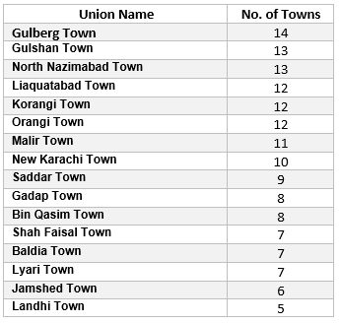

Data
We have access to List of Union Councils of Karachi here then we will use BeautifulSoup to extract the data and pre-process for further evaluation and visualizations.

Slide 4
Methodology
.
Extracted Data from website link given on previous slide
Pre-processed (to make a data-frame for easier analysis)
Found location using FourSquare API
Displayed Map of Neighborhoods
Used k-means for Clustering

Slide 5
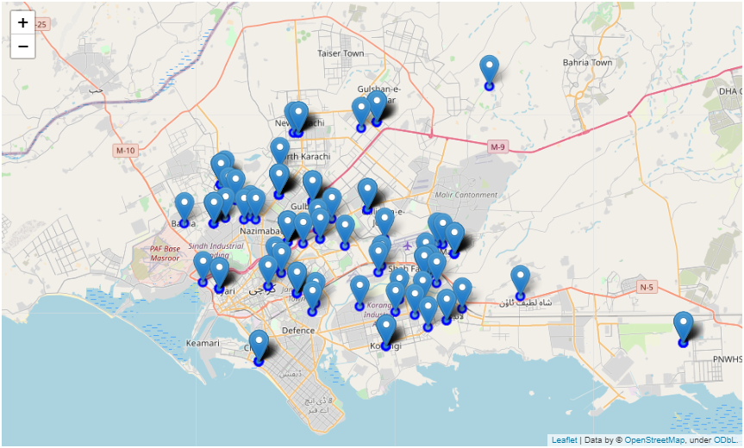
Map of Neighborhoods

Slide 6
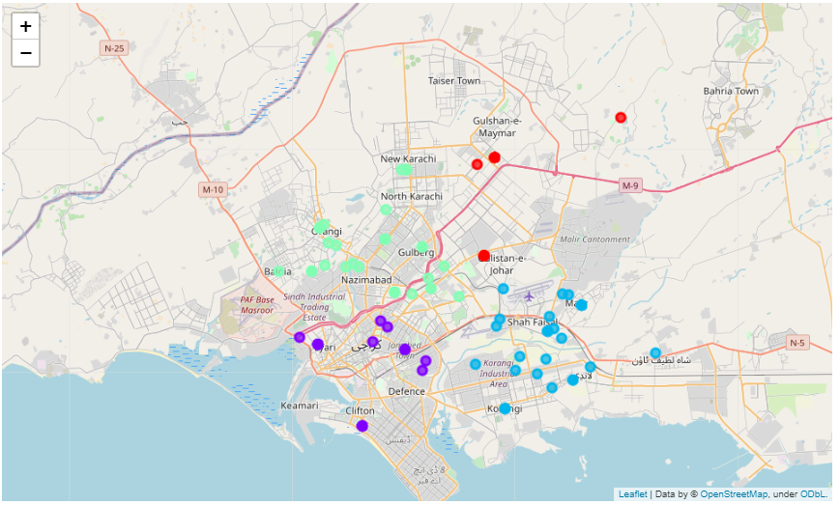
K-Means Clustering

Slide 7
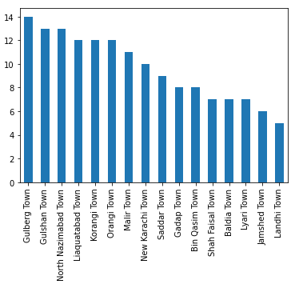
Results
After looking at the Neighbourhoods and above Exploratory Data Analysis we can estimate that "Gulberg Town Karachi" contains 14 towns and also our clustering shows that as well therefore I suggested her to open her start-up at Gulberg Town. because it's the suitable place in Karachi to settle her Dairy.

Slide 8
Conclusion
My boss had an idea and wanted to decide where she should start her Dairy in Karachi. She assigned me the job to analyse the data of Karachi and help her decide. After complete process through wrapping data and processing it for data that we need to analyse and after analysis we found an optimized location for her business and it's "Gulberg Town, Karachi".

Slide 9
Thanks

